Slide 1
Chapter 6 Combinational Logic Design Practices
MSI building blocks are the important element of combinational circuits.

Slide 2
exercises
Part 1: 6.9, 6.20, 6.21, 6.22,
6.38, 6.43, 6.50, 6.51,
Part 2: 6.24, 6.27, 6.52, 6.53, 6.63, 6.74(use circuit to realize)

Slide 3
Emphasis of this chapter
the function of MSIs in this chapter.
Understand the decoder and Multiplexer’s internal structure, and use them to implement logic function with necessary gates.
Be able to analyze and synthesis combinational circuit with MSIs.

Slide 4
6.1 Documentation Standard
1. Signal Names and Active Levels
A better signal name indicates certain meaning, controlling, condition, data and address…
Most signals (signal name) have active level.
active high
active low
Active level for pins
suffix “_L” attaching to signal name represent active low level.
Such as, EN_L、READY_L……
In logic relation, EN_L=EN’， READY_L=READY’。

Slide 5
2. logic symbols and active levels
EN
EN
flg
flg
Active hign
start
start
Dout
Dout
Din
Din
Inversion bubble
Active low
EN_L
EN
flg
flg_L
start_L
start
Dout
Dout
Din
Din
input
output

Slide 6
Exp2：a clock gating circuit, if
①EN=1 (active high), clock signal can be transferred
②EN=0 (active low), clock signal can be transferred
EN
CLK
EN_L
CLK

Slide 7
3. bubble-to-bubble logic design
Make the logic circuit easier to understand.
Exp：
Not match
A
SEL
DATA
B
match
A
ASEL
DATA
B

Slide 8
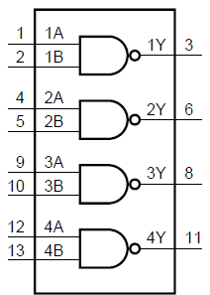
SSI ICs
74××00
74××04
package
……

Slide 9
6.3 Combinational PLDs
1. Programmable logic arrays (PLA)
two level “AND—OR” device.
Can be programmed to implement any sum-of-products logic expression.
An n×m PLA with p product terms:
n—inputs
m—outputs (number of OR gates)
p—product terms (number of AND gates)

Slide 10
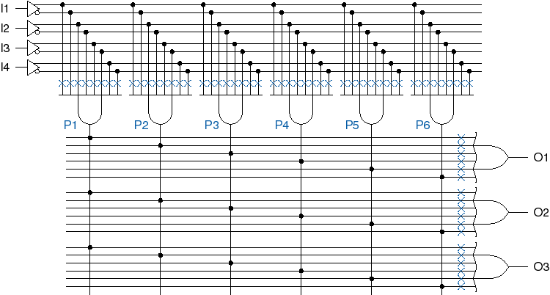
4×3 with 6 product terms
AND array
fuse
OR array

Slide 11

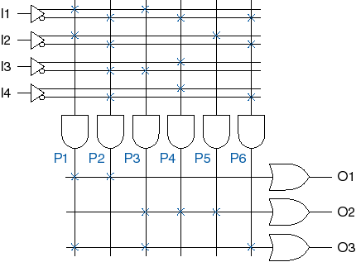

Slide 12
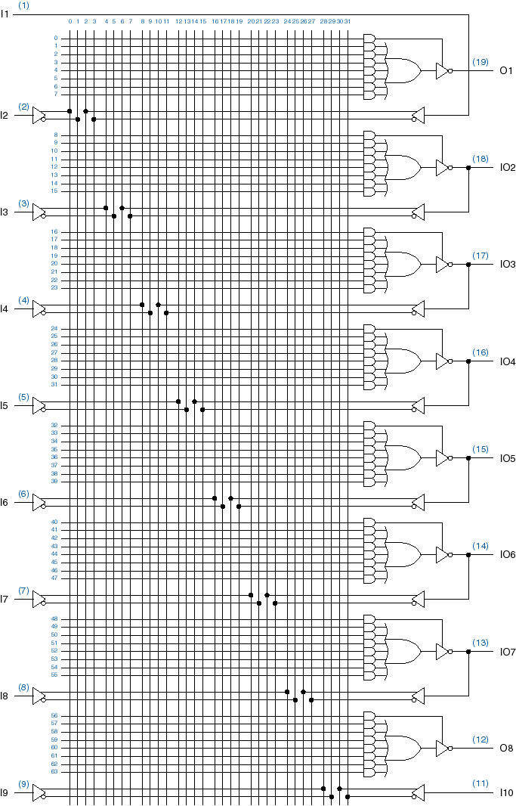
2. Programmable Array Logic Devices
Fixed OR array，programmable AND array
Bidirectional input/output pins，熔丝型
PAL16L8，
Output enable

Slide 13
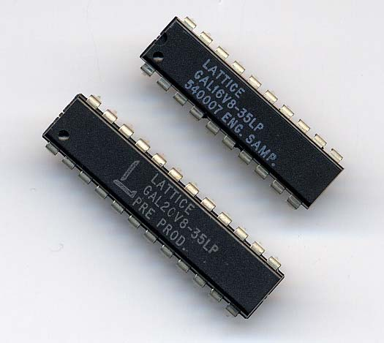
3. Generic Array Logic Devices（GAL）
an innovation of the PAL;
can be erased and reprogrammed;

Slide 14
Classification of Combinational Logic
Combinational Logic Circuit
Arithmatic & Logical Function
Data Transmission
Code Converters
Adders
Subtractors
Comparitors
PLD’s
Multiplexers
Demultiplexers
Encoders
Decoders
Binary
BCD
7-segment

Slide 15
6.4 Decoder
An important type of combinational circuit .
decoder
input code word
n-bit
1-to-1
mapping
m-bit
Output code word
enable input
1-out-of-m code
n<m

Slide 16
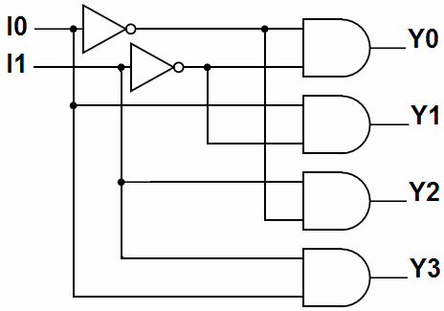
1、binary decoders (n-bit → 2^{n}-bit)
2-4 decoder（2-2²）
Y3
I1
2-4
decoder
Y2
truth table：？
I0
Y1
I1 | I0 | Y3 | Y2 | Y1 | Y0
0 | 0 | 0 | 0 | 0 | 1
0 | 1 | 0 | 0 | 1 | 0
1 | 0 | 0 | 1 | 0 | 0
1 | 1 | 1 | 0 | 0 | 0
Y0
Y_{i}：？
Yi=mi
Y0=I1’·I0’ Y1=I1’·I0
Y2=I1·I0’ Y3=I1·I0
One input combination (minterm) chooses only one output.

Slide 17
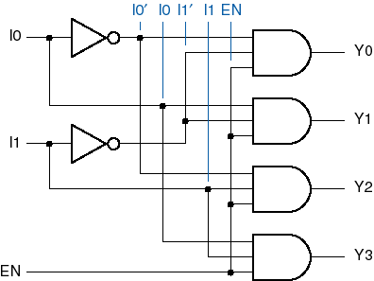
2-4 decoder with enable input
EN | I₁ | I₀ | Y₃ | Y₂ | Y₁ | Y₀
0 | × | × | 0 | 0 | 0 | 0
1 | 0 | 0 | 0 | 0 | 0 | 1
1 | 0 | 1 | 0 | 0 | 1 | 0
1 | 1 | 0 | 0 | 1 | 0 | 0
1 | 1 | 1 | 1 | 0 | 0 | 0
2-4
decoder
Y3
I1
Y2
I0
Y1
EN
Y0
Y_{i}=EN· m_{i}
About the ‘EN’:
When the enable inputs are deasserted, the outputs all take on a default value.  The default is usually 0 if the outputs are asserted high and 1 if they are asserted low.

Slide 18
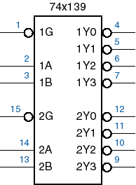
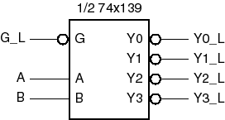
MSI decoder: 74×139 , dual 2-4 decoder
EN
Input code：B（MSB）
A（LSB）
Also be called address input.
Output code：Y3_L~Y0_L

Slide 19
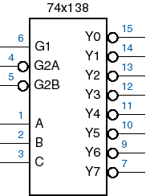
74××138, 3-8 decoder
Enable input
EN=G1·G2A_L’·G2B_L’
Input code：
C（MSB）、B、 A
Output code：
Y0_L ~Y7_L
Yi_L=（EN·m_{i}）’
EN
Y0_L
G1
Y1_L
G2A_L
Y2_L
G2B_L
Y3_L
Y4_L
Y5_L
Y6_L
Y7_L

Slide 20
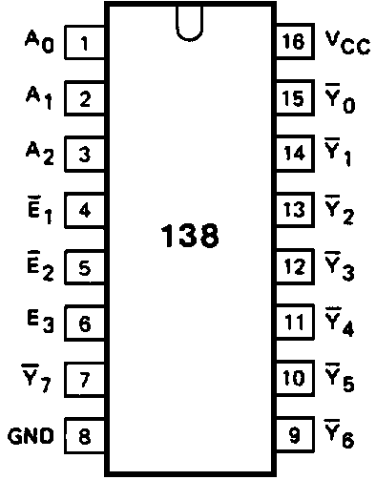
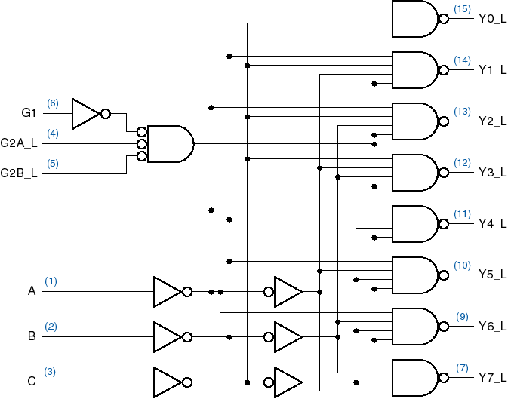
EN
lsb
msb

Slide 21
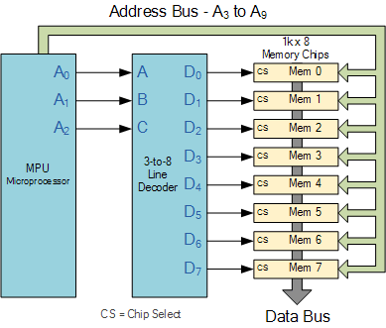
Application: 3-8 decoder in memory address decoding

Slide 22
2. Cascading binary decoders
How to construct a 4-16、5-32 …… decoder？
use multiple 2-4 or 3-8 MSI decoders to cascade.
Design notes：
the number of MSI decoders ?
according to the input and output bits.
only one chip output active level when a binary code data input

Slide 23
Exp：a 4-16 decoder
Inputs: 4-bit N3、N2、N1、N0。
Outputs: 16-bit DEC15_L~DEC0_L
Need 2 pieces of 3-8 decoders.
Use the MSB of the inputs as chip-select bit.
N3 N2 N1 N0
output
N3 N2 N1 N0
output
0000 0001
DEC0_L
DEC1_L
1000 1001
DEC8_L
DEC9_L
…
…
…
…
0111
DEC7_L
1111
DEC15_L

Slide 24
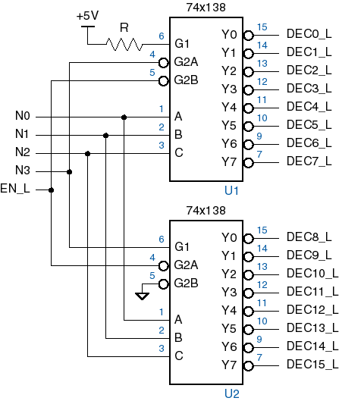
Chip selecting

Slide 25
3. implement canonical sum with decoder ☆
review：canonical sum
Decoder output：Yi_L=(EN·mi)’
when EN=1， Yi_L=mi’ =Mi
How to implement canonical sum
add an NAND gate to the decoder’s output.
Exp: (1) F=∑_{AB}（0、3）
Be viewed as a Minterm generator
U1A
B
1Y0
4
U2A
2
1A
1Y1
5
A
3
1B
F
F=A’·B’+A·B
1
1Y2
6
1G
1Y3
7
74HC00
Enable asserted
74HC139
R1
1k
GND

Slide 26
Exp: （2）if a 3-bit number XYZ is odd number，then F output 1，else output 0. realize the function with decoder and gates.
solution：F=？
F=Σ_{XYZ}（1，3，5，7）
VCC
5V
1k
U1
Z
1
Y0
15
A
Y1
14
Y
2
B
Y2
13
U2A
X
3
C
12
Y3
F
6
G1
Y4
11
4
G2A
Y5
10
5
G2B
Y6
9
74HC20
Y7
7
GND
74HC138

Slide 27
Exp: （3）F=∏_{XYZ}（0、1、5）
solution：
VCC
5V
1k
U1
Z
1
Y0
15
A
Y1
14
U2A
Y
2
B
13
3
C
Y2
X
Y3
12
F
6
G1
Y4
11
4
G2A
Y5
10
74HC11
5
G2B
Y6
9
Y7
7
74HC138
GND

Slide 28
Exp：4-bit prime-number detector. Realizing it with 74×138 and some gates.
V_{CC}
5V
U1
N0
1
A
Y0
15
D0
N1
2
B
Y1
14
D1
Y2
13
N2
R1
3
C
Y3
12
6
G1
Y4
11
1k
4
G2A
Y5
10
N3
5
G2B
Y6
9
U3
D7
Y7
7
74HC138
F
GND
U2
1
A
Y0
15
D8
74HC30D_6V
2
B
Y1
14
Y2
13
V_{CC}
3
C
Y3
12
6
G1
Y4
11
4
G2A
Y5
10
R2
5
G2B
Y6
9
1k
Y7
7
D15
74HC138
GND

Slide 29



4、7-segment decoder
Classify of 7-seg displayer：
in materials:
LED（发光二极管）
LCD（液晶）
In working mode:
common-cathode (共阴极)
common-anode (共阳极)
gnd
g
f
a
b
a
f
b
g
e
c
d
dp
e
d
c
dp
gnd

Slide 30
7-segment decoder transform the BCD code to 7-segment displaying code.
devices：
7446A、74LS47 （驱动共阳）
74LS48、 74LS49（驱动共阴）
74LS49
0000~1001 are useful input codes.
1010~1111 are unused BCD code.

Slide 31
VCC
CK
GND
U2
U1
R1
R6
R7
R8
R9
R10
R11
A
B
C
D
E
F
G
H
5
A
OA
11
1
B
OB
10
2
C
OC
9
4
D
OD
8
OE
6
3
BI
OF
13
OG
12
74LS49

Slide 32
5、BCD decoder（二—十进制译码器）
BCD
decoder
Y0
……
Output:
1-out-of 10 code
Inputs: BCD
Y9
74xx42

Slide 33
6.5 Encoder
1、binary encoder
I₀
binary encoder
I₁
Y₀
output:
……
Y₁
inputs:
……
1-out-of-2^{n}
code
n-bit code
(number)
……
Y_{n-1}
(m=2^{n}-1)
I_{m}
mapping
an object
a code

Slide 34
Exp. 8-3 encoder
input |  |  |  |  |  |  |  | output
I7 | I6 | I5 | I4 | I3 | I2 | I1 | I0 | Y2 | Y1 | Y0
1 | 0 | 0 | 0 | 0 | 0 | 0 | 0 | 1 | 1 | 1
0 | 1 | 0 | 0 | 0 | 0 | 0 | 0 | 1 | 1 | 0
0 | 0 | 1 | 0 | 0 | 0 | 0 | 0 | 1 | 0 | 1
0 | 0 | 0 | 1 | 0 | 0 | 0 | 0 | 1 | 0 | 0
0 | 0 | 0 | 0 | 1 | 0 | 0 | 0 | 0 | 1 | 1
0 | 0 | 0 | 0 | 0 | 1 | 0 | 0 | 0 | 1 | 0
0 | 0 | 0 | 0 | 0 | 0 | 1 | 0 | 0 | 0 | 1
0 | 0 | 0 | 0 | 0 | 0 | 0 | 1 | 0 | 0 | 0
In/out:
active high

Slide 35
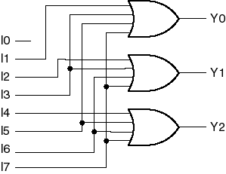
8-3 encoder’s logic expressions and circuit
Y0=I1+I3+I5+I7
Y1=I2+I3+I6+I7
Y2=I4+I5+I6+I7
When an input code is 1-out-of-8, the correct code output for it.

Slide 36
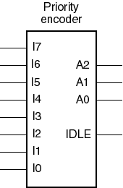
2、Priority Encoder
if multiple inputs are asserted simultaneously, how to deal with?
solution：assign priority to each input from high to low.
let I7— highest priority
and decrease from I6 down to I0
A2,A1,A0—encode output
IDLE—when no input is asserted,
IDLE=1

Slide 37
input |  |  |  |  |  |  |  | output
I7 | I6 | I5 | I4 | I3 | I2 | I1 | I0 | A2 | A1 |  | A0 |  | IDLE
1 | × | × | × | × | × | × | × | 1 |  | 1 |  | 1 | 0
0 | 1 | × | × | × | × | × | × | 1 |  | 1 |  | 0 | 0
0 | 0 | 1 | × | × | × | × | × | 1 |  | 0 |  | 1 | 0
0 | 0 | 0 | 1 | × | × | × | × | 1 |  | 0 |  | 0 | 0
0 | 0 | 0 | 0 | 1 | × | × | × | 0 |  | 1 |  | 1 | 0
0 | 0 | 0 | 0 | 0 | 1 | × | × | 0 |  | 1 |  | 0 | 0
0 | 0 | 0 | 0 | 0 | 0 | 1 | × | 0 |  | 0 |  | 1 | 0
0 | 0 | 0 | 0 | 0 | 0 | 0 | 1 | 0 |  | 0 |  | 0 | 0
0 | 0 | 0 | 0 | 0 | 0 | 0 | 0 | 0 |  | 0 |  | 0 | 1
Expressions for each asserted input in the truth table of priority encoder
H7=I7
H6=I6·I7’
H5=I5·I6’·I7’
H4=I4·I5’·I6’·I7’
H3=I3·I4’·I5’·I6’·I7’
H2=I2·I3’·I4’·I5’·I6’·I7’
H1=I1·I2’·I3’·I4’·I5’·I6’·I7’
H0=I0·I1’·I2’·I3’·I4’·I5’·I6’·I7’
A2=H4+H5+H6+H7
A1=H2+H3+H6+H7
A0=H1+H3+H5+H7
IDLE=(I0+I1+I2+I3+I4+I5+I6+I7)’
=I0’·I1’·I2’·I3’·I4’·I5’·I6’·I7’

Slide 38
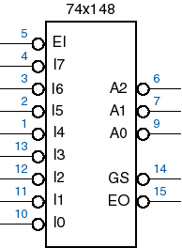
3、74××148 Priority Encoder
EI_L
Enable Input.
I7_L~I0_L：
encode input，I7_L has highest priority.
A2_L~A0_L
encode output
GS_L
GS_L =0 when one or more of the request inputs are asserted.
EO_L
enable output
EO_L=0 when I7_L=I6_L=…=I1_L=1 and EI_L=0.
hign
priority
low

Slide 39
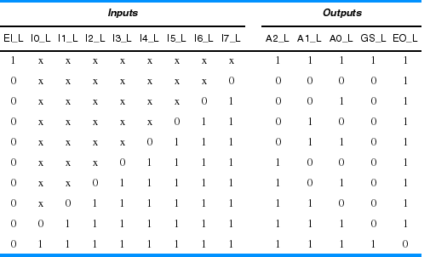
74××148 truth table

Slide 40
4、cascading priority encoder
problem：how to construct 16-4、32-5 …… priority encoder？
Connecting multiple 8-3 encoders.
note：
make sure the needed number of chips according to the inputs.
need to redesign the output circuit that could produce the correct encoding output.

Slide 41
Example ：16-4 priority encoder
use two pieces of 74××148 U1, U2，
U1: input E15_L~E8_L;
U2: input E7_L~E0_L;
and E15_L is the highest priority,
output: D3_L~D0_L，active low;
When one or more inputs is asserted，GS_L=0；when no input is asserted ,GS_L=1 and D3_L~D0_L=1111.

Slide 42
16-4 priority encoder
U1
EN15_L
D7
U3A
EN14_L
D6
A0
D0_L
EN13_L
D5
A1
EN12_L
A2
EN11_L
D4
74HC08
D3
GS
U3B
EN10_L
D2
EO
EN9_L
D1
D1_L
EN8_L
D0
EI
74HC08
74HC148
U3C
U2
D2_L
EN7_L
D7
74HC08
EN6_L
D6
A0
EN5_L
D5
A1
EN4_L
A2
D3_L
EN3_L
D4
D3
GS
U3D
EN2_L
D2
EO
EN1_L
D1
GS_L
EN0_L
D0
EI
74HC08
74HC148

Slide 43
question：if the decoder’s outputs are active high, then how to modify the circuit?
U1
EN15_L
D7
U3A
EN14_L
D6
A0
D0
EN13_L
D5
A1
EN12_L
A2
EN11_L
D4
74HC08
D3
GS
U3B
EN10_L
D2
EO
EN9_L
D1
D1
EN8_L
D0
EI
74HC08
74HC148
U3C
U2
D2
EN7_L
D7
74HC08
EN6_L
D6
A0
EN5_L
D5
A1
EN4_L
D4
A2
D3
EN3_L
D3
GS
U3D
EN2_L
D2
EO
EN1_L
D1
GS
EN0_L
D0
EI
74HC08
74HC148

Slide 44
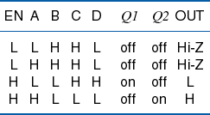

6.6 Three-state Devices
1、three-state buffers

Slide 45



EN_L
EN
A
OUT
A
OUT_L
Enable means:
the buffer output normal logic 0、1 when EN is asserted；
the buffer output Hi-Z when EN is negated.
EN_L
A
OUT_L

Slide 46
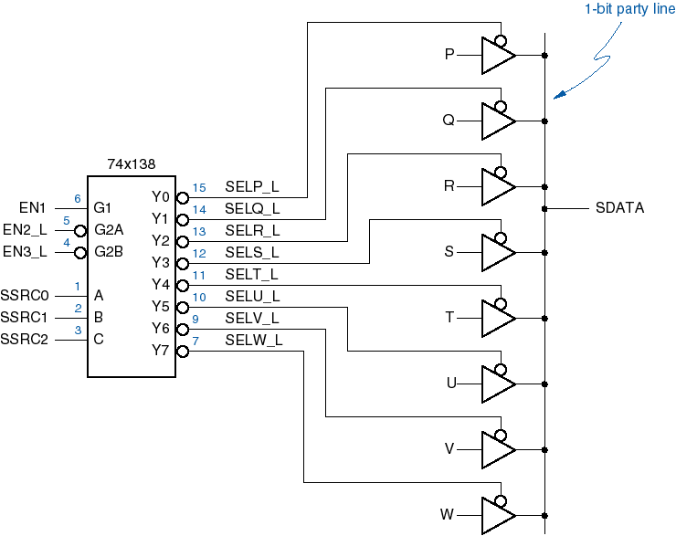
application
1-bit party line
…
…
…
…
address of data source
return

Slide 47
Data fighting on the three-state parity line
SSRC
…
000
001
010
011
…
P
…
T_{PL(H)Z}
Q
…
T_{PZL(H)}
generally， T_{PLZ} 、T_{PHZ} < T_{PZL} 、T_{PZH}
But, to confirm the correction in application, a control logic is adopted.

Slide 48
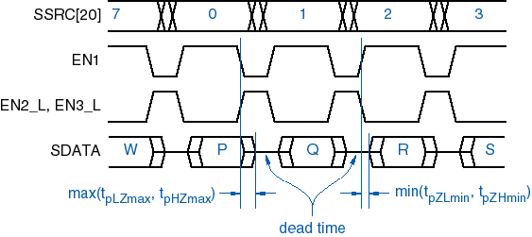
截止时间 （停滞时间）
Logic circuit

Slide 49
6.7 Multiplexer
A
S=0， Y=A
S=1，Y=B
B
Y=A
2-to-1 MUX
S=0
A
Logic circuit
B
Y=B
S=1
A
Y
B
Y=SEL’·A+SEL·B
SEL

Slide 50
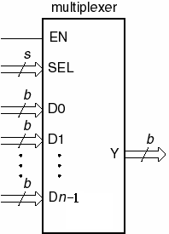
1、structure
( MUX for short )
SEL: selecting input, choose one data source to output
Y : output
enable
select
n data source
data output
( n≤2^{s})
mj：SEL[j] minterm

Slide 51
1-bit n-1 MUX
Let b=1,
D0
D1
Each output equals the selected input.
The MUX works just as a n-to-1 switch.
…
Y
Dj
…
Dn-1
S-bit
SEL
EN

Slide 52
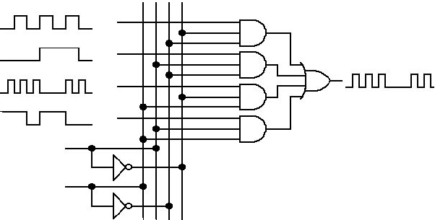
Exp:4-to-1 MUX
A
1
B
output
2
C
3
C
D
4
S0
0
1
S1 | S0 | output
0 | 0 | A
0 | 1 | B
1 | 0 | C
1 | 1 | D
S1
1
0

Slide 53
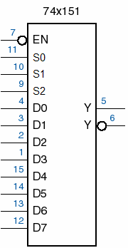
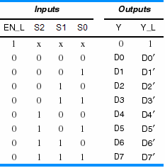
2、MSI MUX
（1）8-to-1 MUX ，74××151
EN_L
address
Y
Y_L

Slide 54
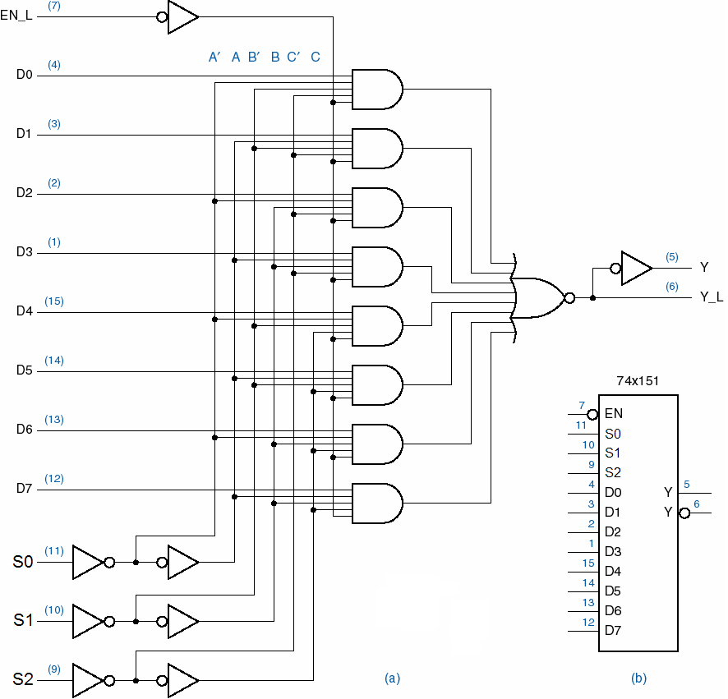
return

Slide 55
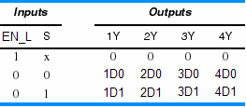
（2）4-bit, 2 input MUX ，74××157
74×157
15
EN
1
S
2
1D0
3
1D1
1Y
4
5
2D0
7
6
2D1
2Y
11
3D0
3Y
9
10
3D1
14
4D0
4Y
12
13
4D1

Slide 56
input |  |  |  | output
1G_L | 2G_L | B | A | 1Y | 2Y
0 | 0 | 0 | 0 | 1C0 | 2C0
0 | 0 | 0 | 1 | 1C1 | 2C1
0 | 0 | 1 | 0 | 1C2 | 2C2
0 | 0 | 1 | 1 | 1C3 | 2C3
0 | 1 | 0 | 0 | 1C0 | 0
0 | 1 | 0 | 1 | 1C1 | 0
0 | 1 | 1 | 0 | 1C2 | 0
0 | 1 | 1 | 1 | 1C3 | 0
1 | 0 | 0 | 0 | 0 | 2C0
1 | 0 | 0 | 1 | 0 | 2C1
1 | 0 | 1 | 0 | 0 | 2C2
1 | 0 | 1 | 1 | 0 | 2C3
1 | 1 | × | × | 0 | 0
（3）2 bit, 4 input MUX，74×× 153
74×153
1G_L
1
1G
2G_L
15
2G
14
A
2
B
6
1C0
1Y
7
5
1C1
4
1C2
2Y
9
3
1C3
10
2C0
11
2C1
12
2C2
13
2C3

Slide 57
3、Expanding MUXs
Exp1：use 74××151 to implement a 16-to-1 MUX, some gates can be used if necessary.
Chips needed：
according to the 16 inputs, need two 74××151 chips U1 & U2.
output：
combine two chip’s outputs (Y1&Y2) into one output (Y).
Input:
Data input : D0~D15
Select input : A0~A3(msb)

Slide 58
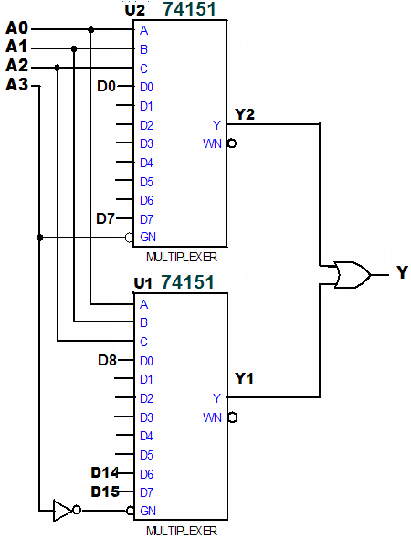
The MSB(A3) of input act as the chip-select bit.

Slide 59
Exp2：用74××153实现4输入，4位MUX，。
设4路输入分别是：1D[3..0]、2D[3..0]、3D[3..0]、4D[3..0]；
4位输出是：Dout[3..0]
输入选择：S1、S0
解：无需外加门，只需要合理安排输入、输出数据端口即可。

Slide 60
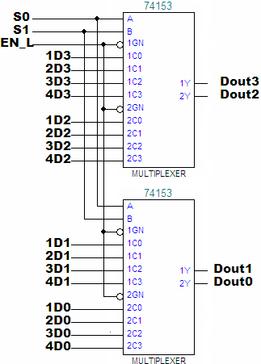

Dout3
S1S0

Slide 61
4. Implement canonical sum with MUX (supplement)
74×151’s
internal circuit
multiple input, 1 bit MUX, the output：
when EN is asserted：
as same as the canonical sum form.
m_{j}: minterm of the select (address) inputs.

Slide 62
EXP. A 3-bit majority circuit
F
AB
A
C
0 | 0 | 1 | 0
0 | 1 | 1 | 1
C
B
F=∑_{ABC}(3,5,6,7)
=A’ ·B·C+A·B’ ·C+A·B·C’+A·B·C
=m₃+m₅+m₆+m₇
=1·m₃+1·m₅+1·m₆+1·m₇
= 1·m₃+1·m₅+1·m₆+1·m₇ +0·m₀+0·m₁+0·m₂+0·m₄

Slide 63
MUX’s data input ports correspond to the output of the truth table each other.
MUX’s address input act as the minterm generator.
truth table:
output value
input variable
according to the
minterm number
MUX:
data input port
address input

Slide 64
Exp1：a circuit output 1 when its 3-bit input can be divided by 3. construct the circuit by using 74××151.
So：F=∑_{X,Y,Z}（？）
and circuit？
V_{CC}
U1
R1
4
D0
Y
5
F
3
D1
2
D2
~Y
6
1
D3
15
D4
14
D5
13
D6
12
D7
Z
11
S0
Y
10
S1
X
9
S2
7
EN
GND

Slide 65
Exp2：if the inputs are 4-bits in Exp.1, then how to design the circuit with MUX?
Solution 1：use a 16-1 MUX to design , choose a 74××150。
F=∑_{WXYZ}（0，3，6，9，12，15）
Solution 2：仍选用74××151，先对所求函数的卡诺图做降维处理。
预备知识：卡诺图的降维
用一个n变量的卡诺图来处理m变量的函数（n<m），这种卡诺图被称为降维（降次）的卡诺图。它允许单元格中除了0、1、无关项外，还可包含单变量或逻辑表达式。

Slide 66
卡诺图的降维
将被合并
卡诺图降次的过程：
设m=n+1，在m-变量函数F(X₁,X₂,…,X_{n},X_{n+1})中选择一个“入图”的变量X_{i}，用剩下的n个变量构造n-变量卡诺图。原图中变量X_{i}取值相反所覆盖的相邻的两个单元格被合并。（这两个单元格的其余变量是相同的；在真值表中对应着两行，只有X_{i}是不同的，其余变量均相同。）
F
W
W X
00
01
11
10
Y Z
00
01
Z
11
Y
10
选择入图
X

Slide 67
降维后的输出变量的重新表达
①从真值表观察，表中的输入变量是除X_{i}而外剩下的变量，新行号由他们的组合值（最小项）确定。
②若在原(n+1)变量真值表中，被合并的两行的入图变量X_{i}与对应的F取值相同，则新表中F=X_{i},
W | X | Y | Z | F | F_{new}
× | × | × | 0 | 0 | Z
× | × | × | 1 | 1
W、X、Y取值相同

Slide 68
③被合并的两行的入图变量X_{i}与对应的F取值相反，则新表中F=X_{i}’
④被合并的两行的入图变量X_{i}所对应的F=1，则新表中F=1
⑤被合并的两行的入图变量X_{i}所对应的F=0，则新表中F=0
⑥用MUX实现
(若有无关项，一般(1,d)→(1),(0,d)→(0),(d,d)→(d))
W | X | Y | Z | F | F_{new}
× | × | × | 0 | 1 | Z’
× | × | × | 1 | 0
W | X | Y | Z | F | F_{new}
× | × | × | 0 | 1 | 1
× | × | × | 1 | 1
W | X | Y | Z | F | F_{new}
× | × | × | 0 | 0 | 0
× | × | × | 1 | 0

Slide 69
新编号
输入 |  |  |  | 输出
W | X | Y | Z | F
0 | 0 | 0 | 0 | 1
0 | 0 | 0 | 1 | 0
0 | 0 | 1 | 0 | 0
0 | 0 | 1 | 1 | 1
0 | 1 | 0 | 0 | 0
0 | 1 | 0 | 1 | 0
0 | 1 | 1 | 0 | 1
0 | 1 | 1 | 1 | 0
新输出
F
Z’
Z
0
Z’
新编号
输入 |  |  |  | 输出
W | X | Y | Z | F
1 | 0 | 0 | 0 | 0
1 | 0 | 0 | 1 | 1
1 | 0 | 1 | 0 | 0
1 | 0 | 1 | 1 | 0
1 | 1 | 0 | 0 | 1
1 | 1 | 0 | 1 | 0
1 | 1 | 1 | 0 | 0
1 | 1 | 1 | 1 | 1
新输出
F
Z
0
Z’
Z
0
4
1
5
2
6
3
7

Slide 70
降维后的三变量真值表，用74x151实现
W | X | Y | F
0 | 0 | 0 | Z’
0 | 0 | 1 | Z
0 | 1 | 0 | 0
0 | 1 | 1 | Z’
1 | 0 | 0 | Z
1 | 0 | 1 | 0
1 | 1 | 0 | Z’
1 | 1 | 1 | Z
U1
4
D0
Y
5
F
3
D1
2
D2
Y
6
1
D3
Z
15
D4
Z’
14
13
D5
12
D6
D7
Y
11
S0
X
10
S1
W
9
S2
7
G
GND

Slide 71
卡诺图中降维
原4变量卡诺图
新3变量卡诺图
F_{new1}
W
F
W
W X
W X
Y
00
01
11
10
Y Z
Z’
0
Z’
Z
00
1
0
1
0
Z
Z’
Z
0
0
0
0
1
Y
01
Z
1
0
1
0
X
11
F_{new2}
Y
W
10
0
1
0
0
W X
Z
Y’
Y
Y’
0
X
Y
0
Y
Y’
Z
X

Slide 72
5.Multiplexers、Demultiplexers and Buses
demultiplexers
demultiplexers
D₀
D₁
2^{n} bit parallel output
1-bit
……
D_{in}
…
n-bit
SEL
D_{m}
No DeMUX chips, a binary decoder with enable input can be used as a DeMUX.

Slide 73
Mux & demux can be used to transmit several low speed signals on a single wire.
MUX：transform m-bit parallel-input data into serial-output data.
DeMUX：route the bus data to 1 of m destinations.
SRCA
DSTA
SRCB
DSTB
SRCC
BUS
DSTC
MUX
De -MUX
…
…
SRCZ
DSTZ
SRCSEL
DSTSEL

Slide 74

（1）MUX：parallel — serial conversion
0
8-to-1 MUX
D0
Serial data output
1
D1
Parallel input data
0
D2
1
D3
0
D4
Y
1
D5
0
D6
1
D7
S2
S1
S0
t

Slide 75
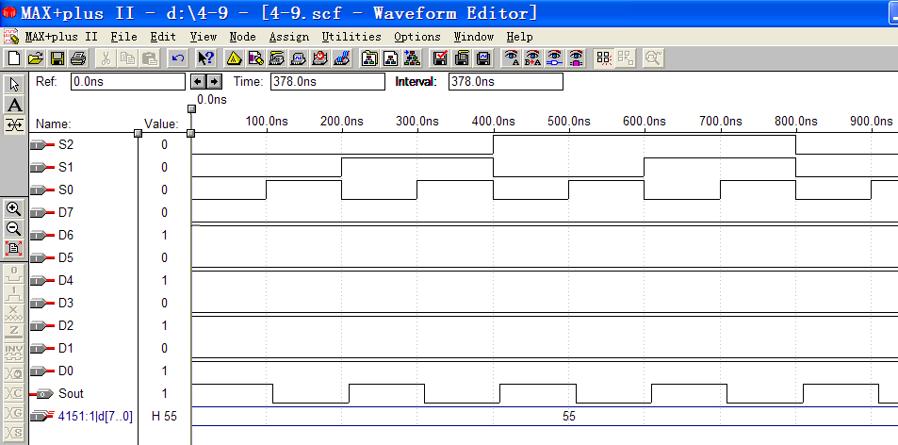

Slide 76
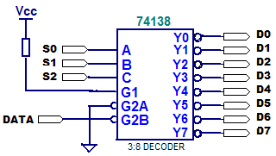
（2）DeMUX: serial — parallel conversion
Use a 74××138 as a DeMUX.

Slide 77

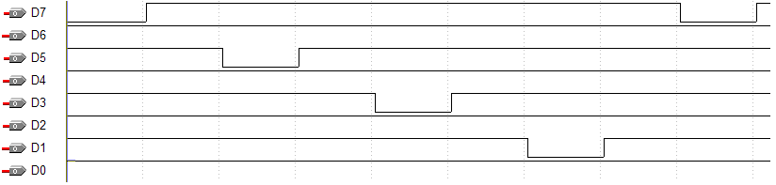
Diagram of Exp.
S₂S₁S₀
111
110
101
100
011
010
001
000
0
1
0
1
0
1
0
1

Slide 78
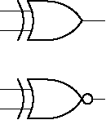
6.8 Exclusive-OR gates and Parity circuits
1、XOR and XNOR gates
（X⊙Y）
X | Y | X⊕Y | (X⊕Y)’
 |  | XOR | XNOR
0 | 0 | 0 | 1
0 | 1 | 1 | 0
1 | 0 | 1 | 0
1 | 1 | 0 | 1
XOR
XNOR
记忆：异或门—相同为0，相异为1
异或非门—与异或相反
Back to comparator

Slide 79
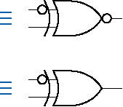
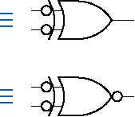
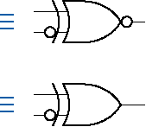
Properties
X⊕0=X X⊕1=X’
X⊕X=0 X⊕X’=1
X⊕Y= Y ⊕ X
X⊕Y⊕Z=(X⊕Y)⊕Z=X⊕(Y⊕Z)
Equivalent symbols
Any two signals (inputs or outputs) of an XOR or XNOR gate may be complemented without changing the resulting logic function.

Slide 80
Feature of XOR expression (k-map)
X⊕Y⊕Z=X’·Y·Z’+X·Y’·Z’+X’·Y’·Z+X·Y·Z
W⊕X⊕Y⊕Z=W’·X’·Y’·Z+W’·X’·Y·Z’+W’·X·Y’·Z’
+W’·X·Y·Z+W·X’·Y’·Z’+W·X’·Y·Z+W·X·Y’·Z+W·X·Y·Z’
XYZ
010
100
001
111
F
X
X Y
The number of ‘1’ contained in each input combination is an odd number.
Z
00
01
11
10
0
0
1
0
1
1
1
0
1
0
Z
Y

Slide 81
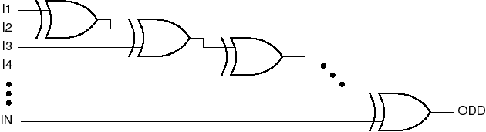
2、parity circuits
Cascade n XOR gates to form a n+1 inputs odd-parity circuit. It means that its output 1 if an odd number of its inputs are 1.
ODD=I1⊕I2⊕……⊕In
Daisy-chain connection

Slide 82
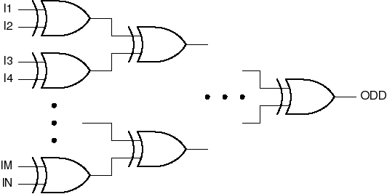
Tree structure，has faster operation speed.
Complement the output of odd-parity circuit，it can works as an Even-parity which output 1 if an even number of its input are 1.

Slide 83
Parity code (奇偶校验码)(supplement)
Be composed of n-bit data + 1-bit parity bit
Even parity code：if the number of ‘1’ included in an n-bit data is odd, then the even-parity bit should be set 1. So the total number of ‘1’ in the (n+1)-bit code data is even.
Odd parity code：if the number of ‘1’ included in an n-bit data is even, then the odd-parity bit should be set 1. So the total number of ‘1’ in the (n+1)-bit code data is odd.

Slide 84
Example for parity circuit
Exp： a circuit adapts odd parity, if input data is 3-bit, please give the parity-bit generator.
B2 | 0 | 0 | 0 | 0 | 1 | 1 | 1 | 1
B1 | 0 | 0 | 1 | 1 | 0 | 0 | 1 | 1
B0 | 0 | 1 | 0 | 1 | 0 | 1 | 0 | 1
P | 1 | 0 | 0 | 1 | 0 | 1 | 1 | 0
input
output
P=B2’ ·B1’ ·B0’+B2’ ·B1·B0+B2·B1’ ·B0+B2·B1·B0’
=(B2⊕B1⊕B0)’
B2
Circuit:
B1
P
74HC386
B0
74HC386
74HC04

Slide 85
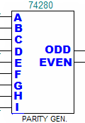
3、74×280 9-bit parity generator
Generate the parity bit when a code word is stored or transmitted.
Check the parity bit when a code word is retrieved or received.
EVEN=A⊕B⊕C⊕D⊕E⊕F⊕(G⊕H⊕I)’
ODD=A⊕B⊕C⊕D⊕E⊕F⊕G⊕H⊕I

Slide 86
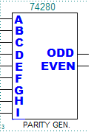
2
ERROR
0
1
RD
WR
1
0
data
RD
EN
data
buffer
WR
memory
1
PIN
POUT
ODD=A⊕B⊕C⊕D⊕E⊕F⊕G⊕H⊕I
=PIN=POUT

Slide 87
6.9 Comparators
Comparator
compares two binary number and indicates whether they are equal.
Magnitude comparator
interpret the binary number as signed or unsigned numbers and also indicate an arithmetic relationship (greater or less than).

Slide 88


1、structure of comparator
XOR\XNOR truth table
（1）1-bit comparator
（2）multiple-bit comparator
parallel comparator
iterative comparator
DIFF=A0⊕B0
EQ=（A0⊕B0）’

Slide 89
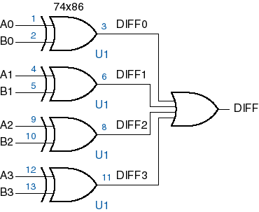
Parallel comparator
Each of the input-bit pairs is compared simultaneously.
4-bit parallel comparator
Iterative comparator (serial comparator)

Slide 90
2. Iterative Circuit
Cascade n identical modules
PI₀
PI₁
PI_{n-1}
C₀
PI
C₁
PI
C₂
C_{n-1}
PI
C_{n}
…
CI
CO
CI
CO
CI
CO
PO
PO
PO
boundary inputs
boundary output
PO₀
PO₁
PO_{n-1}
cascading input
cascading output
All modules have the same function.

Slide 91
comparator module
iterative comparator
X
Y
EQO
EQI
lower speed, but be easy to expand
X0
Y0
X1
Y1
X_{n-1}
Y_{n-1}
X
Y
X
Y
X
Y
EQ1
EQ2
EQn
…
1
EQO
EQO
EQO
EQI
EQI
EQI

Slide 92
3. Magnitude comparators
（1）1-bit magnitude comparators
A | B | F(A>B) | F(A=B) | F(A<B)
0 | 0 | 0 | 1 | 0
0 | 1 | 0 | 0 | 1
1 | 0 | 1 | 0 | 0
1 | 1 | 0 | 1 | 0
F_{A>B}= A·B’
F_{A=B}= A’ ·B’+A·B
F_{A<B}=A’ ·B
A
F_{A<B}
F_{A=B}
F_{A>B}
B

Slide 93
（2） multiple-bit Magnitude comparators
2-bit ，input A[1..0]、B[1..0]
A1 | B1 | A0 | B0 | F_{A>B} | F_{A=B} | F_{A<B}
0 | 1 | × | × |  |  | 1
1 | 0 | × | × | 1
0 | 0 | 0 | 0 |  | 1
0 | 0 | 0 | 1 |  |  | 1
0 | 0 | 1 | 0 | 1
0 | 0 | 1 | 1 |  | 1
1 | 1 | 0 | 0 |  | 1
1 | 1 | 0 | 1 |  |  | 1
1 | 1 | 1 | 0 | 1
1 | 1 | 1 | 1 |  | 1
F_{A>B}=A1·B1’
+A1’·B1’·A0·B0’
+A1·B1·A0·B0’
=A1·B1’
+(A1⊕B1)’ ·A0·B0’
F_{A=B}=A1’·B1’·A0’·B0’
+A1’·B1’·A0·B0
+A1·B1·A0’·B0’
+A1·B1·A0·B0
=(A1⊕B1)’ ·(A0⊕B0)’
F_{A<B}=A1’·B1
+A1’·B1’·A0’·B0
+A1·B1·A0’·B0
=A1’·B1
+(A1⊕B1)’ ·A0’·B0

Slide 94
A1 | B1 | A0 | B0 | F_{A>B} | F_{A=B} | F_{A<B}
A1<B1 |  | × | × |  |  | 1
A1>B1 |  | × | × | 1
A1=B1 |  | A0<B0 |  |  |  | 1
A1=B1 |  | A0>B0 |  | 1
A1=B1 |  | A0=B0 |  |  | 1
Pseudo-logic
F_{A>B}=(A1>B1)+(A1=B1)· ( A0>B0)
= A1·B1’ + (A’B’+AB)·(A1·B1’ )
F_{A=B}=(A1=B1)·(A0=B0)
F_{A<B}=(A1<B1)+(A1=B1)·(A0<B0)

Slide 95
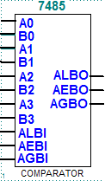
4. Standard MSI magnitude comparator
74×85: 4-bit
Magnitude input:
A[3..0], B[3..0]
Cascading input：
ALBI、AEBI、AGBI，which are used to expanding comparator.
output：
ALBO、AEBO、AGBO
AGBO=(A>B)+(A=B)·AGBI
AEBO=(A=B)·AEBI
ALBO=(A<B)+(A=B)·ALBI

Slide 96
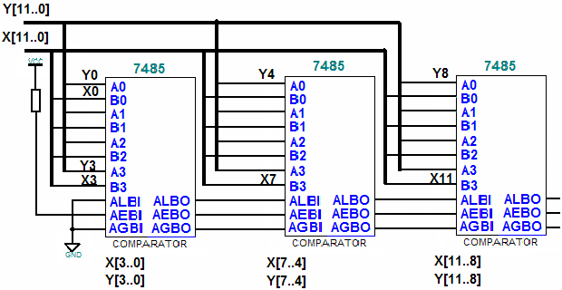
Cascading magnitude comparator
in serial mode: iterative comparator
F_{A<B}
F_{A=B}
F_{A>B}

Slide 97
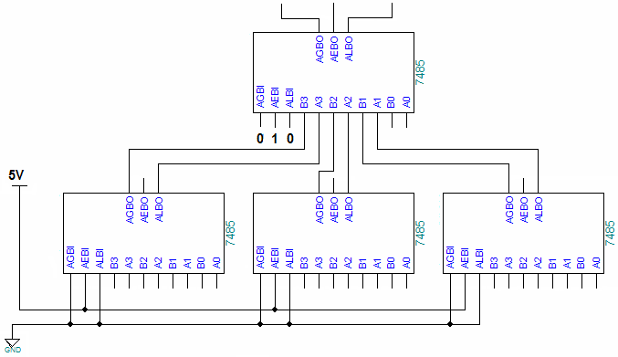
in parallel mode
F_{X<Y}
F_{X=Y}
F_{X>Y}
U1
U2
U3
X[11..8]
X[7..4]
X[3..0]
Y[11..8]
Y[7..4]
Y[3..0]

Slide 98
6.10 Adders、Subtractors and ALU
Used to do binary addition and subtraction
1. Half adders and full adders
（1）half adders
X | Y | HS | CO
0 | 0 | 0 | 0
0 | 1 | 1 | 0
1 | 0 | 1 | 0
1 | 1 | 0 | 1
half sum：HS=X⊕Y
carry-out：CO=X·Y
X
HS
Y
CO

Slide 99
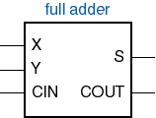
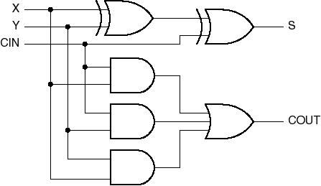
（2）full adders
CIN | X | Y | S | CO
0 | 0 | 0 | 0 | 0
0 | 0 | 1 | 1 | 0
0 | 1 | 0 | 1 | 0
0 | 1 | 1 | 0 | 1
1 | 0 | 0 | 1 | 0
1 | 0 | 1 | 0 | 1
1 | 1 | 0 | 0 | 1
1 | 1 | 1 | 1 | 1
sum：S=X⊕Y⊕CIN
carry：CO=X·Y+CIN·X+CIN·Y

Slide 100
2、ripple adders
Use 1-bit full adder as a module to construct n-bit ripple adder.
X0
Y0
X1
Y1
Xn-1
Yn-1
X
Y
X
Y
X
Y
Cn
C1
C2
…
C0
CIN
CO
CIN
CO
CO
S
S
S
S0
S1
Sn-1
Expanding easily, but has lower speed

Slide 101
3、carry-lookahead adders
Parallel adders
issues：how to get the carry information early?
solution： carry-lookahead
（1）definition：
①carry generating variable：g_{i}=x_{i}·y_{i}
②carry propagating variable：p_{i}=x_{i}+y_{i}
③the C_{i+1} carry-out：C_{i+1}=g_{i}+p_{i}·C_{i}
( C_{o}=X·Y+C_{i}·(X+Y) )

Slide 102
C_{i+1}=g_{i}+p_{i}·(g_{i-1}+p_{i-1}·(…(g₀+p₀·C₀) …)
C₀=0，
C_{i} is relative to addends only
The adder just has three level delay, which to reduce the calculating time.
（2）structure
S_{i}=X_{i}⊕Y_{i}⊕C_{i}
C_{i+1}=g_{i}+p_{i}·C_{i}
Two-level AND-OR expression
X_{i}
Y_{i}
Si
X₀
Carry-lookahead logic
C_{i}
…
X_{i-1}
Y₀
…
Y_{i-1}
C₀

Slide 103
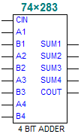
MSI adders - 74×283
4-bit carry-lookahead adders
加法器的级联（P.482图6-89）

Slide 104
Exp. 1-digit BCD adder
4-bit
Adder
(74×283)
S1[3:0]
S[3:0]
A[3:0]
4-bit
Adder
(74×283)
B[3:0]
Verifying
circuit
C_{o1}
C_{i}
C_{o2}
BCD
input
S1≤9, S=S1+0
S1>9, S=S1+6
Here, S≥10, C_{o}=1;
So need a new carry generator
For 74×283, S1 ≤ 15, C_{o1}=0;
S1>15, C_{o1}=1

Slide 105
U1
U2
S[3:0]
12
A4
SUM_4
10
12
A4
SUM_4
10
A[3:0]
14
A3
SUM_3
13
14
A3
SUM_3
13
3
A2
SUM_2
1
3
A2
SUM_2
1
5
A1
SUM_1
4
5
A1
SUM_1
4
11
B4
U4
11
B[3:0]
15
B3
U6
15
B4
2
B2
Y7
7
2
B3
6
B1
5
G2B
Y6
9
6
B2
4
G2A
Y5
10
B1
7
C0
C4
9
6
G1
Y4
11
7
C0
C4
9
3
Y3
12
2
C
Y2
13
74HC283D_6V
B
Y1
14
74HC283D_6V
GND
1
A
Y0
15
GND
74HC138D_6V
74HC30D_6V
U5A
GND
Co
74HC32D_6V

Slide 106
4、subtractor
Full subtractor
D=X⊕Y⊕B_{IN}
B_{O}=B_{IN}·Y+B_{IN}·X’+X’·Y
B_{IN} | X | Y | D | B_{O}
0 | 0 | 0 | 0 | 0
0 | 0 | 1 | 1 | 1
0 | 1 | 0 | 1 | 0
0 | 1 | 1 | 0 | 0
1 | 0 | 0 | 1 | 1
1 | 0 | 1 | 0 | 1
1 | 1 | 0 | 0 | 0
1 | 1 | 1 | 1 | 1
X
D
Y
B_{O}
B_{IN}

Slide 107
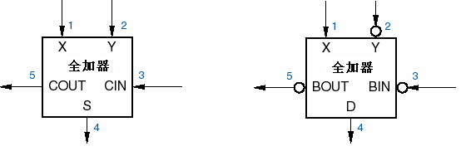
Subtraction can be operated by using addition.
X-Y= X+(Y)_{2’s}= X+(Y)_{1s’}+1
so：D=X⊕Y’⊕B_{IN}’
B_{O}=(B_{IN}’ ·X+B_{IN}’ ·Y’ +X·Y’)’
B_{O}
B_{IN}
D
subtractor

Slide 108
5、MSI arithmetic and logic units
perform a number of different arithmetic and logical operations.
G
SEL
P
M
A=B
C_{IN}
ALU
C_{O}
A
F
B

Slide 109
Class exercise 2
①
②
③
④
⑤
⑥
⑦
⑧
X
Please derive the minimal sum of the timing diagram.
Try to realize it with a 74xx151 chip.
Y
Z
F

Slide 110
Class exercise 3
Try to implement such an encoder that output Gray code G2G1G0 corresponding to the input IN0~IN7. (no priority)

Slide 111
Chapter 2
number systems
Conversion between two different radix- number
Binary signed number’s expression (S-M, 2’s, 1s’)
Arithmetic operation (addition, subtraction, overflow…)
Code
8421BCD, excess-3, 2421: feature
Gray code : feature, conversion between binary number and gray code.

Slide 112
Chapter 3
CMOS gates properties
Basic concept: logic level, logic convention…
CMOS logic: switching feature, internal structure…
Static electrical behavior
Dynamic electrical behavior
Other input and output structure
Noise margin, fan-out
Propagation delay in timing diagram
Transmission gate, three-state gate, open-drain (wire logic), schmitt-trigger input

Slide 113
Chapter 4
Switching algebra
Axioms and theorems
Standard representation of logic functions
Minterm, maxterm, canonical sum, canonical product, minterm list, maxterm list…
Combinational-circuit analysis
Truth table
Logic function
Timing diagram
Judge whether the hazard exist or not

Slide 114
Chapter 4
Combinational-circuit synthesis
Find the logic relationship between inputs and output.
K-map
Minimal sum, minimal product

Slide 115
Chapter 6
The feature of each device
How to expanding its original function
Realize other function with these device
Synthesize combinational circuit with 74xx138 or 74xx151…

Slide 116
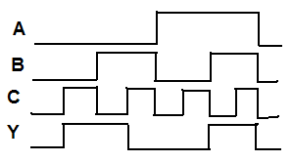
例1、用MSI器件实现3-bit 二进制码到Gray码的转换。
例2、用加法器74×283及一些恰当的器件实现1位BCD码的加法。
例3、假定某电路的工作波形如图所示，试找出其最简实现方案，用门电路实现；再用74×138和74×151实现。
输入
输出

